Slide 1
CMP5329-Cyber Security
Week 1_P2: Modern Asymmetric Ciphers
PhD. Ngoc-Tu Nguyen
tunn@uit.edu.vn

Slide 2
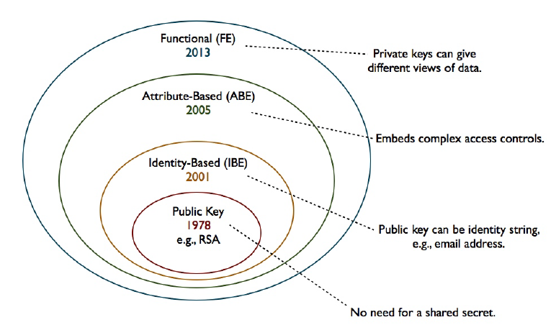





Moden Asymmetric ciphers
Symmetric cipher vs Asymmetric cipher
Hommophic, Searchable encryption,..
$ID_{A}(atributes)$
$ID_{B}(atributes)$
$$(PK_{A}, \{SK_{A},SK_{B},..\})$$
ID
$$(PK_{A}, SK_{A})$$
$$(PK_{A}, SK_{A})$$

Slide 3
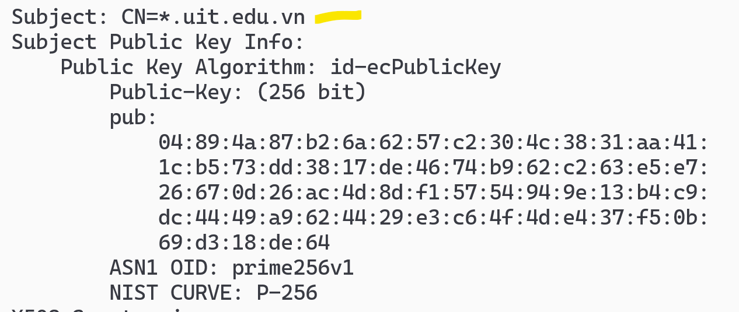
Web’s Server Public Key
openssl s_client -connect <server>:<port> -showcerts
openssl s_client -connect google.com:443 –showcerts
View in X590 format
openssl s_client -connect uit.edu.vn:443 -showcerts 2>NUL | openssl x509 -text -noout

Slide 4
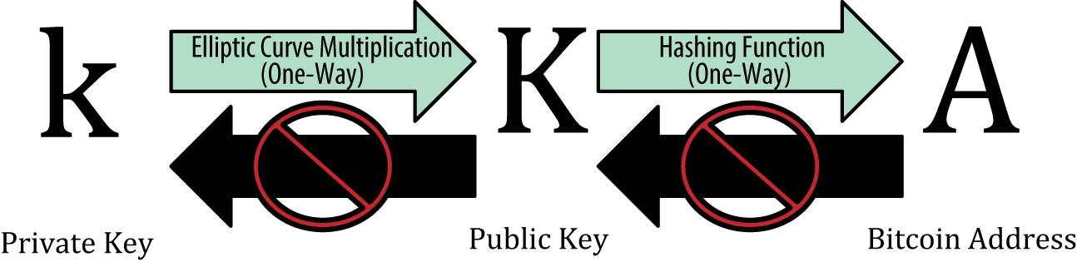
Example

Slide 5
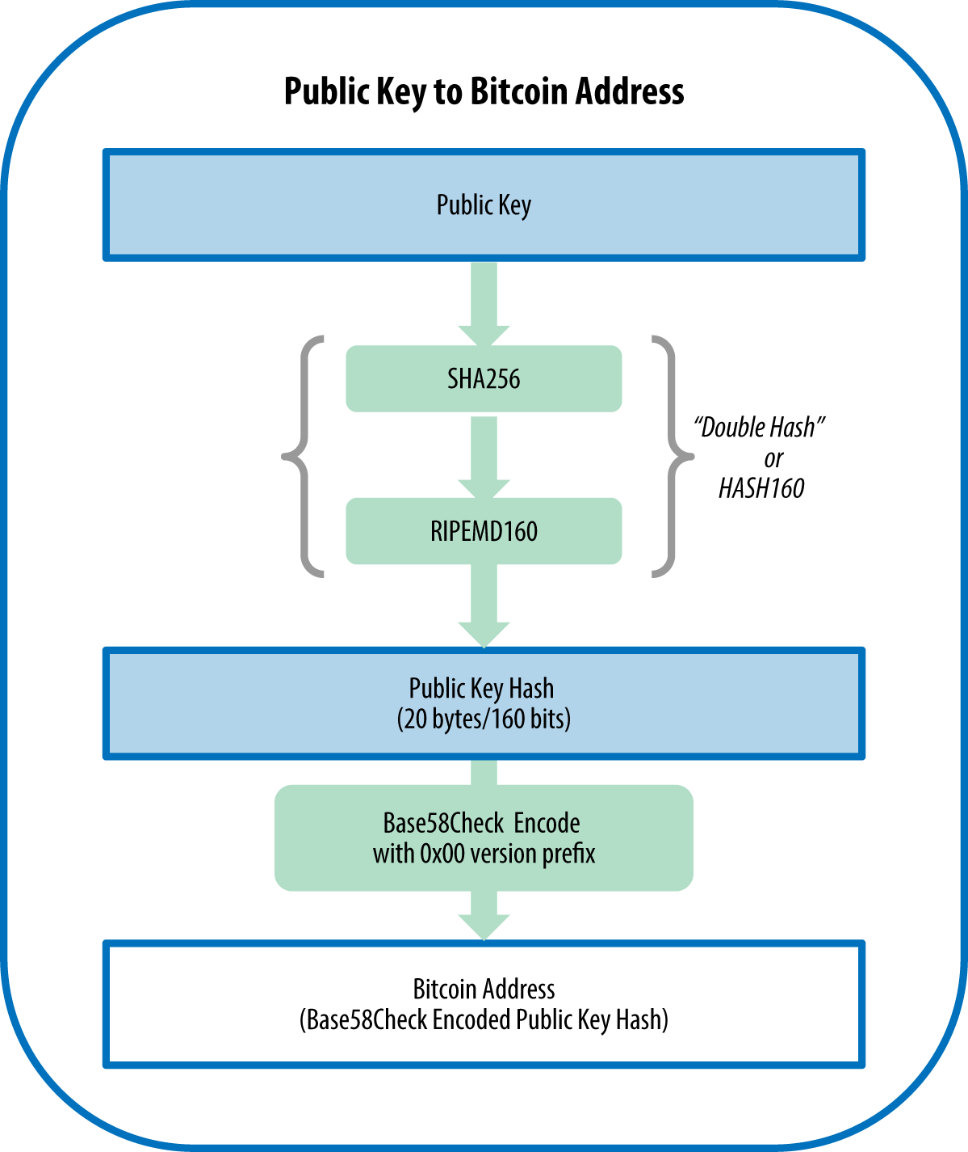
Example

Slide 6
Public-Key Cryptosystems
A public-key encryption scheme has six ingredients:
Plaintext
The readable message or data that is fed into the algorithm as input
Encryption algorithm
Performs various transforma-tions on the plaintext
Public key
Used for encryption or decryption
Private key
Used for encryption or decryption
Ciphertext
The scrambled message produced as output
Decryption algorithm
Accepts the ciphertext and the matching key and produces the original plaintext
Notes:
Asymmetric algorithms rely on one key for encryption and a different but related
key for decryption. These algorithms have the following important characteristic.
• It is computationally infeasible to determine the decryption key given only
knowledge of the cryptographic algorithm and the encryption key.
In addition, some algorithms, such as RSA, also exhibit the following characteristic.
• Either of the two related keys can be used for encryption, with the other used
for decryption.
A public-key encryption scheme has six ingredients (Figure 9.1a; compare
with Figure 3.1).
• Plaintext: This is the readable message or data that is fed into the algorithm as
input.
• Encryption algorithm: The encryption algorithm performs various transformations
on the plaintext.
• Public and private keys: This is a pair of keys that have been selected so that
if one is used for encryption, the other is used for decryption. The exact transformations
performed by the algorithm depend on the public or private key
that is provided as input.
• Ciphertext: This is the scrambled message produced as output. It depends on
the plaintext and the key. For a given message, two different keys will produce
two different ciphertexts.
• Decryption algorithm: This algorithm accepts the ciphertext and the matching
key and produces the original plaintext.

Slide 7
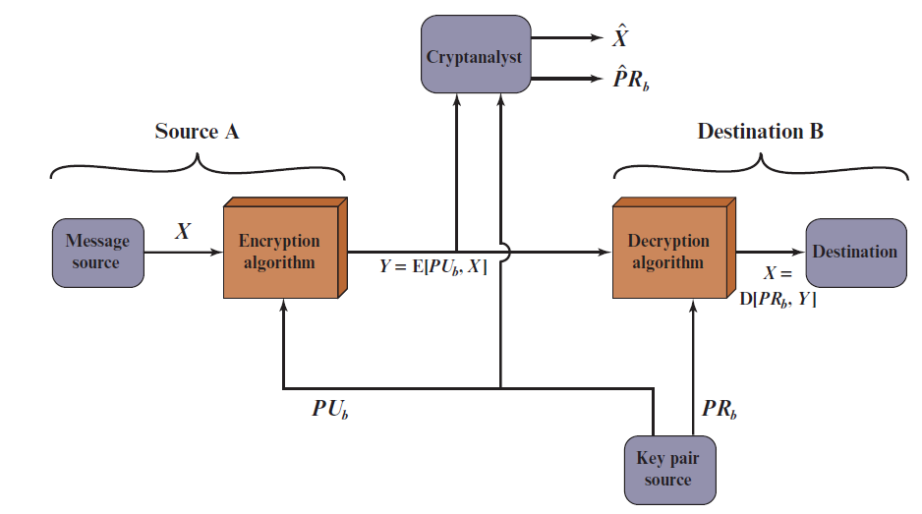
Public-Key Cryptosystem: Confidentiality
Public-Key Cryptosystem: Confidentiality
Notes:
Let us take a closer look at the essential elements of a public-key encryption
scheme, using Figure 9.2 (compare with Figure 3.2).
The scheme illustrated in Figure 9.2 provides confidentiality.

Slide 8
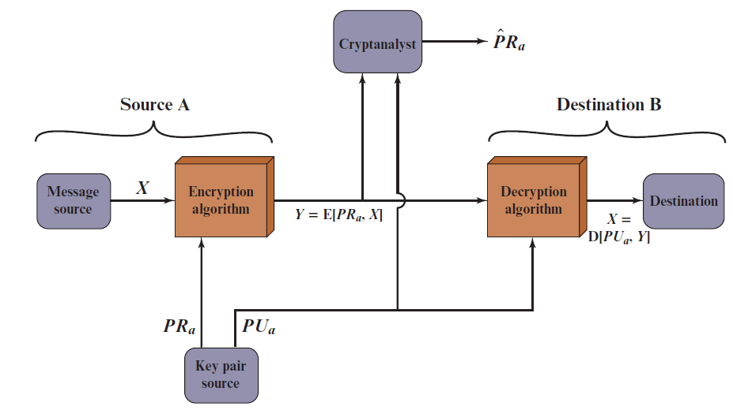
Public-Key Cryptosystem: Data Authentication
Public-Key Cryptosystem: Authentication
Notes:
We mentioned earlier that either of the two related keys can be used for encryption,
with the other being used for decryption. This enables a rather different
cryptographic scheme to be implemented. Whereas the scheme illustrated in
Figure 9.2 provides confidentiality, Figures 9.1b and 9.3 show the use of public-key
encryption to provide authentication.
It is important to emphasize that the encryption process depicted in
Figures 9.1b and 9.3 does not provide confidentiality. That is, the message being
sent is safe from alteration but not from eavesdropping. This is obvious in the
case of a signature based on a portion of the message, because the rest of the
message is transmitted in the clear. Even in the case of complete encryption,
as shown in Figure 9.3, there is no protection of confidentiality because any
observer can decrypt the message by using the sender’s public key.

Slide 9
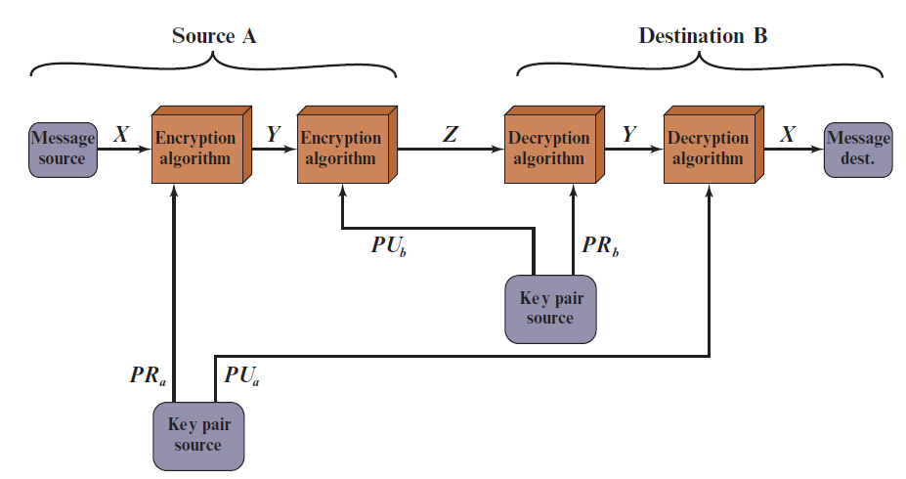
Public-Key Cryptosystem: Authentication and Secrecy
Public-Key Cryptosystem: Authentication and Secrecy
Notes:
It is, however, possible to provide both the authentication function and confidentiality
by a double use of the public-key scheme (Figure 9.4).
In this case, we begin as before by encrypting a message, using the sender’s private
key. This provides the digital signature. Next, we encrypt again, using the receiver’s
public key. The final ciphertext can be decrypted only by the intended receiver, who
alone has the matching private key. Thus, confidentiality is provided. The disadvantage
of this approach is that the public-key algorithm, which is complex, must be
exercised four times rather than two in each communication.

Slide 10
Prime factorization problem
“Prime factorization one-way function!”
Input: large prime number and a large number $e$
Easy to compute
$d=e^{−1}\operatorname{mod}{(}p−1)(q−1)$, e.d =1 mode (p-1)(q-1)
C = M ^{e} mod n
Input:
“Hard” to compute
C^{d} mod n=M^{e.d} mod n = M^{e.d mod(p-1)(q-1)} mod n = M

Slide 11
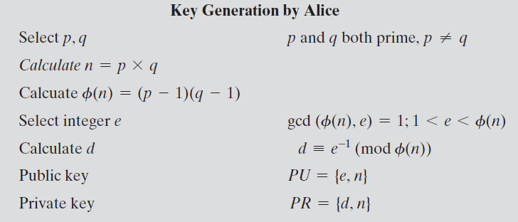
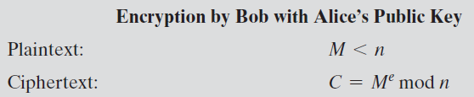
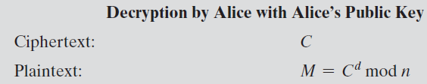

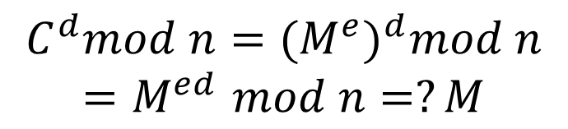
The R S A Algorithm
$$e.d=1 mod φ(n)$$
$$C^{d}mod n={{(M}^{e})}^{d}mod n$$
$${=M}^{ed}mod n=?M$$
Notes:
Figure 9.5 summarizes the RSA algorithm. It corresponds to Figure 9.1a: Alice
generates a public/private key pair; Bob encrypts using Alice’s public key; and Alice
decrypts using her private key.

Slide 12
R S A Algorithm
RSA makes use of an expression with exponentials
Plaintext is encrypted in blocks with each block having a binary value less than some number n
Encryption and decryption are of the following form, for some plaintext block M and ciphertext block C
C = Me mod n
M = C^{d} mod n = (Me)^{d} mod n = M^{ed} mod n
Both sender and receiver must know the value of n
The sender knows the value of e, and only the receiver knows the value of d
This is a public-key encryption algorithm with a public key of PU={e,n} and a private key of PR={d,n}

Slide 13
Algorithm Requirements
For this algorithm to be satisfactory for public-key encryption, the following requirements must be met:
It is possible to find values of e, d, n such that M^{ed} mod n = M for all M < n
It is relatively easy to calculate Me mod n and C^{d} mod n for all values of M < n
It is infeasible to determine d given e and n
Notes:
For this algorithm to be satisfactory for public-key encryption, the following requirements
must be met.
1. It is possible to find values of e, d, and n such that M^{ed} mod n = M for all M < n .
2. It is relatively easy to calculate Me mod n and C^{d} mod n for all values of M < n .
3. It is infeasible to determine d given e and n .

Slide 14
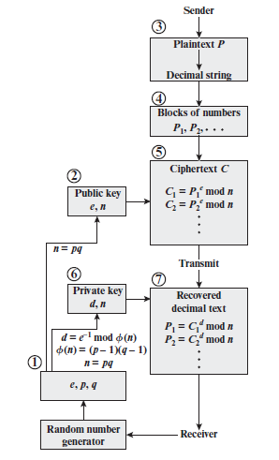
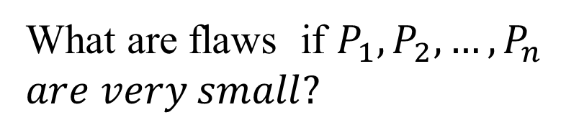
R S A Processing of Multiple Blocks
What are flaws if $P_{1}, P_{2}, …,P_{n}$
$are very small?$

Slide 15
Moden Asymmetric ciphers
Symmetric cipher vs Asymmetric cipher
Hommophic, Searchable encryption,..
$ID_{A}(atributes)$
$ID_{B}(atributes)$
$$(PK_{A}, \{SK_{A},SK_{B},..\})$$
ID
$$(PK_{A}, SK_{A})$$
$$(PK_{A}, SK_{A})$$

Slide 16


RSA: Confidentiality
A
B
$d_{A}$ / $n_{A}, e_{A}$
$d_{B}$ / $n_{B}, e_{B}$
$$e_{A}.d_{A}=1 mod φ(n_{A})$$
$$e_{B}.d_{B}=1 mod φ(n_{B})$$
$$C =m^{e_{B}} mod n_{B}$$
$$C^{d_{B}} mod n_{B} ={(m^{e_{B}})}^{d_{B}} mod n_{B}$$
= $m$
Protect secret key?
Distribute public keys?
Notes:
Let us take a closer look at the essential elements of a public-key encryption
scheme, using Figure 9.2 (compare with Figure 3.2).
The scheme illustrated in Figure 9.2 provides confidentiality.

Slide 17
RSA: Authentication
A
B
$d_{A}$ / $n_{A}, e_{A}$
$d_{B}$ / $n_{B}, e_{B}$
$$S =m^{d_{A}} mod n_{A}$$
$$(m,S )$$
Verify message $m$
$$S^{e_{A}} mod n_{A} ={(m^{d_{A}})}^{e_{A}} mod n_{A}$$
$$=m′$$
$?= m$
Protect secret key?
Distribute public keys?
Sent by A
Original (integrity)
Notes:
Let us take a closer look at the essential elements of a public-key encryption
scheme, using Figure 9.2 (compare with Figure 3.2).
The scheme illustrated in Figure 9.2 provides confidentiality.

Slide 18
RSA: Authentication and Secrecy
A
B
$d_{A}$ / $n_{A}, e_{A}$
$d_{B}$ / $n_{B}, e_{B}$
$$S =k^{d_{A}} mod n_{A}$$
$$(C_{1}=k^{e_{B}},{S_{1}=S}^{e_{B}} )$$
Decrypt and verify the secret key $k$
$$C_{1}^{d_{B}} mod n_{B} ={(k^{e_{B}})}^{n_{B}} mod n_{B}=k;$$
$$S_{1}^{d_{B}} mod n_{B} ={(S^{e_{B}})}^{n_{B}} mod n_{B}=S;$$
$$S^{e_{A}} mod n_{A} ={(k^{d_{A}})}^{e_{A}} mod n_{A}=k^{′}=?k$$
Limitation?
Notes:
Let us take a closer look at the essential elements of a public-key encryption
scheme, using Figure 9.2 (compare with Figure 3.2).
The scheme illustrated in Figure 9.2 provides confidentiality.

Slide 19
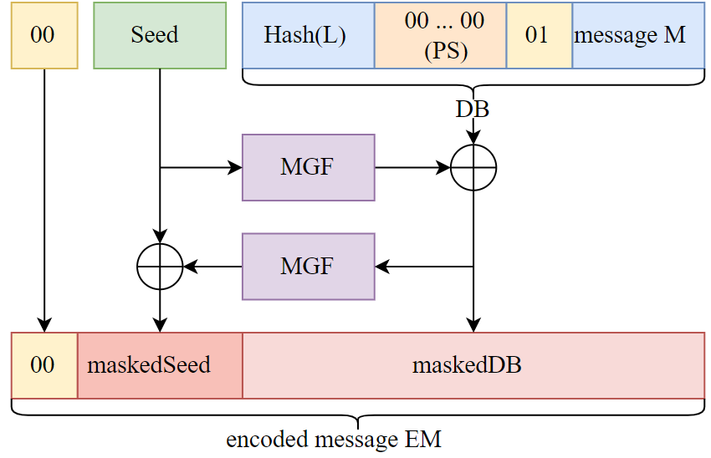
Encryption Using Optimal Asymmetric Encryption Padding (O A E P)
MGF: a hash function
$$K$$
message $K$
$$DB=H(L)||0000.. ||01||K$$
Y = MGF(Seed) ⊕ DB
X= MGF(Y) ⊕ Seed
?
X
Y

Slide 20
Outline
Why asymmetric cryptography?
Factoring Based Cryptography
Logarithm Based Cryptography
ElGamal cipher;
Diffie-Hellman key exchange;
Elliptic Curve Cryptography
Some advanced cryptography system (quantum resistance)
Notes:
Cipher=a secret system of writing;

Slide 21
Discrete Logarithm problem
$$Finitemultiplicative group \left(G, .\right)=<g> =\{g^{n}:n∈ ℤ\}$$
AutoSeededRandomPool prng;
Integer p, q, g;
CryptoPP::PrimeAndGenerator pg;
pg.Generate(1, prng, 512, 511);
p = pg.Prime();
q = pg.SubPrime();
g = pg.Generator();
Example: $G=ℤ_{p}\backslash \{0\}= \left\{1,2,…,p−1\right\}=<g>$
Easy to compute
$$y_{0}=g^{n} mod p$$
$$g, n$$
Hard to solve $n$
${g, y}_{0},$ p
$$g^{n}=y_{0} mod p$$
Hard to solve equation $g^{x}=a mod p in finite field!$

Slide 22
Outline
Why asymmetric cryptography?
Factoring Based Cryptography (P1)
RSA signature;
Logarithm Based Cryptography (P2)
ElGamal cipher
Diffie-Hellman key exchange;
Elliptic Curve Cryptography (P3)
Some advanced cryptography system (quantum resistance)
Notes:
Cipher=a secret system of writing;

Slide 23
ElGamal cipher
ElGamal parameters
Large prime number$: p$
Multiplicative group
$$G=\left\langle g\right\rangle =ℤ_{p}\backslash \{0\}=\{1,2,…, p−1\}$$
Key generation (
Secret key: $x∈_{R}[1,p−1]$
Public key: $h=g^{x}mod p∈ℤ_{p}$
Notes:
The DSA is based on the difficulty of computing discrete logarithms (see Chapter 2)
and is based on schemes originally presented by Elgamal [ELGA85] and Schnorr
[SCHN91].
Figure 13.3 summarizes the algorithm.
There are three parameters that are public and can be common to a group of users. An N-bit prime number q is chosen. Next, a prime number p is selected with a length between 512 and 1024 bits such that q divides (p - 1). Finally, g is chosen to be of the form h^{(p-1)/q} mod p, where h is an integer between 1 and (p - 1) with the restriction that g must be greater than 1. Thus, the global public-key components of DSA are the same as in the Schnorr sig- nature scheme.
With these parameters in hand, each user selects a private key and generates a public key. The private key x must be a number from 1 to (q - 1) and should be chosen randomly or pseudorandomly. The public key is calculated from the private key as y = g^{x} mod p. The calculation of y given x is relatively straight- forward. However, given the public key y, it is believed to be computationally infeasible to determine x, which is the discrete logarithm of y to the base g, mod p (see Chapter 2).
The signature of a message M consists of the pair of numbers r and s, which are functions of the public key components (p, q, g), the user’s private key (x), the hash code of the message H(M), and an additional integer k that should be generated randomly or pseudorandomly and be unique for each signing.
Let M, r′, and s′ be the received versions of M, r, and s, respectively. Verification is performed using the formulas shown in Figure 13.3. The receiver generates a quantity v that is a function of the public key components, the sender’s public key, the hash code of the incoming message, and the received versions of r and s. If this quantity matches the r component of the signature, then the signature is validated.

Slide 24
ElGamal cipher
Encryption message $m<p−1$(using public key $h=g^{x}$ )
Choose a random number$: r ∈_{R}\left[1,p−1\right]$
Compute $C_{1}=g^{r}mod p$;
Computer $C_{2}=m.h^{r} mod p$
Output cipher message $(C_{1},C_{2})$
Decryption $(C_{1},C_{2})$ (using secret key $x$ )
Compute ${\left(C_{1}\right)}^{x}mod p=g^{r.x}mod p$;
Computer $\frac{C_{2}}{{\left(C_{1}\right)}^{x}} mod p=\frac{m.g^{x.r}}{g^{r.x}} mod p$
$=m$
Output message $m$

Slide 25
ElGamal cipher
A
public key
B
public key
?
public key
private key
$$PU_{B}=h_{B},p$$
$$(PR_{B}=x_{B}, PU_{B}={h_{B}=g}^{x_{B}},p)$$
Input: $M <p$
$${(C}_{1},C_{2})$$
Compute:
Select a random number$: r<p−1$
Compute: $C_{1}=g^{r} mod p$
$C_{2}=m.h_{B}^{r} mod p$
$$\frac{C_{2}}{{\left(C_{1}\right)}^{x_{B}}} mod p$$
$$=\frac{m.g^{x_{B}.r}}{g^{r.x_{B}}} mod p=m$$

Slide 26
Outline
Why asymmetric cryptography?
Factoring Based Cryptography (P1)
RSA signature;
Logarithm Based Cryptography (P2)
ElGamal cipher
Diffie-Hellman key exchange;
Elliptic Curve Cryptography (P3)
Some advanced cryptography system (quantum resistance)
Notes:
Cipher=a secret system of writing;

Slide 27
Diffie-Hellman key exchange
A and B never met and share no secrets;
Public info: the prime number $p$ and $g$
$p$ is a large prime number, $g$ is a generator of Z_{p}*
Z_{p}* = {1, 2 … p-1: ∀a∈Z_{p}* ∃i such that $a=g^{i} mod p$}
Pick secret, random $x$
Pick secret, random $y$
$$X=g^{x} mod p$$
A
$$Y=g^{y} mod p$$
B
Compute
$k_{A}=Y^{x} mod p={{(g}^{y})}^{x}mod p$
$=g^{y.x} mod p$
Compute
$k_{B}=X^{y}={(g^{x})}^{y}mod p$
$=g^{xy}mod p$
Session key $K= k_{A}$ $= k_{B}=g^{x.y}$
Symmetric key

Slide 28
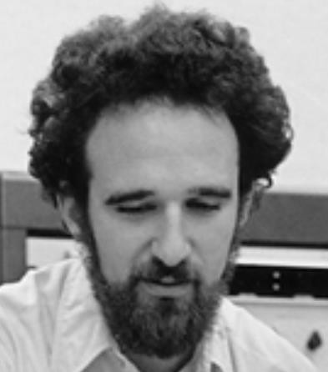
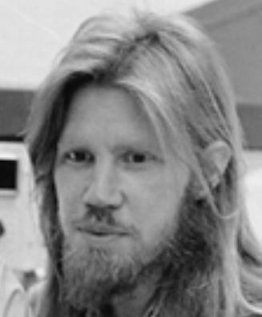
Diffie-Hellman exchange Protocol (DHE)
p = 1606938044258990275541962092341162602522202993782792835301301
𝑔 = 123456789
𝑔^{𝑎} mod p = 78467374529422653579754596319852702575499692980085777948593
𝑔^{𝑏} mod p =
560048104293218128667441021342483133802626271394299410128798
𝑎 =
685408003627063
761059275919665
781694368639459
527871881531452
𝑏 =
362059131912941
987637880257325
269696682836735
524942246807440
𝑔^{𝑎𝑏} mod p = 437452857085801785219961443000845969831329749878767465041215
${{(g}^{b})}^{a}$ $mod p$
$${{(g}^{a})}^{b}mod p$$

Slide 29
Why Is Diffie-Hellman Secure?
Discrete Logarithm (DL) problem:
given g^{x} mod p, it’s hard to extract x
There is no known efficient algorithm for doing this
This is not enough for Diffie-Hellman to be secure!
Computational Diffie-Hellman (CDH) problem:
given g^{x} and g^{y}, it’s hard to compute g^{xy} mod p
… unless you know x or y, in which case it’s easy
Decisional Diffie-Hellman (DDH) problem:
given g^{x} and g^{y}, it’s hard to tell the difference between g^{xy} mod p and g^{r} mod p where r is random

Slide 30
Properties of Diffie-Hellman
Assuming DDH problem is hard, Diffie-Hellman protocol is a secure key establishment protocol against passive attackers
Eavesdropper can’t tell the difference between the established key and a random value
Can use the new key for symmetric cryptography
Basic Diffie-Hellman protocol does not provide authentication
IPsec combines Diffie-Hellman with signatures, anti-DoS cookies, etc.

Slide 31

Man-in-the middle attacks the DHE
$$g^{a} mod p$$
$$(a,g^{a})$$
$$(b,g^{b})$$
$$g^{b} mod p$$
$$sk={{(g}^{b})}^{a}={{(g}^{a})}^{b}=g^{ab}mod p$$
B()
A(Putin)
man-in-the-middle attack!
$$g^{m} mod p$$
$$g^{a} mod p$$
$$g^{m} mod p$$
$$g^{b} mod p$$
$$sk_{1}=g^{am}mod p$$
$$sk_{2}=g^{bm}mod p$$

Slide 32
Advantages of Pblic-Key Crypto
Confidentiality without shared secrets
Very useful in open environments
Can use this for key establishment, avoiding the “chicken-or-egg” problem
With symmetric crypto, two parties must share a secret before they can exchange secret messages
Authentication without shared secrets
Encryption keys are public, but must be sure that Alice’s public key is really her public key
This is a hard problem… Often solved using public-key certificates

